Slide 1


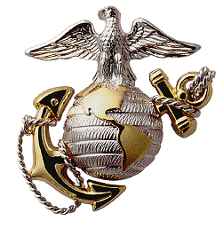

Certificate of Appreciation
To all who shall see these presents, Greeting:
This is to Certify that
Mrs. Danielle N. DuRivage
Has earned grateful appreciation for her unselfish, faithful, and devoted service during her husband’s Marine Corps Career. Your unfailing support and understanding helped to make possible your husband’s lasting contribution to this Command and the United States Marine Corps. We fully realize that the support and understanding you have displayed was not provided without hardship and sacrifice during his tour of duty with Headquarters Battalion, 2d Marine Division.
It gives us great pleasure to present you with this certificate.
Given under my hand this 14th day of June 2024.
D.K. BURROWS, COL, USMC
Commanding Officer

Slide 2
Certificate of Appreciation
To all who shall see these presents, Greeting:
This is to Certify that
Daniel R. DuRivage
Has earned grateful appreciation for his unselfish, faithful, and devoted service during his father’s Marine Corps Career. Your unfailing support and understanding helped to make possible your father’s lasting contribution to this Command and the United States Marine Corps. We fully realize that the support and understanding you have displayed was not provided without hardship and sacrifice during his tour of duty with Headquarters Battalion, 2d Marine Division.
It gives us great pleasure to present you with this certificate.
Given under my hand this 14th day of June 2024.
D.K. BURROWS, COL, USMC
Commanding Officer

Slide 3
Certificate of Appreciation
To all who shall see these presents, Greeting:
This is to Certify that
Presley M. DuRivage
Has earned grateful appreciation for his unselfish, faithful, and devoted service during his father’s Marine Corps Career. Your unfailing support and understanding helped to make possible your father’s lasting contribution to this Command and the United States Marine Corps. We fully realize that the support and understanding you have displayed was not provided without hardship and sacrifice during his tour of duty with Headquarters Battalion, 2d Marine Division.
It gives us great pleasure to present you with this certificate.
Given under my hand this 14th day of June 2024.
D.K. BURROWS, COL, USMC
Commanding Officer

